Slide 1



Sonipat Global Industrial Township
Integrated Township in Sonipat
Industrial Plots
Warehousing
Residential
Commercial
Investor Presentation 2022

Slide 2

Table of Content
Section | Particulars
Section I- Group Overview | 1. Group Structure
 | 2. Directors Profile
 | 3. Organic Harvest
 | 4. Transaction with GoodGlamm
Section II- Proposed Maruti Suzuki Manufacturing Plant | Overview Newspaper clippings Over Advantage
Section – III Project Overview | 1. Company Structure
 | 2. Cost of Project & Means of Finance
 | 3. Potential Clientele
 | 4. Locational Advantages
 | 5. Land Details
 | 6. Expansion Plan
 | 7. Our Proposal

Slide 3


Group Overview

Slide 4

Group Structure
Pulsar Chem Pvt. Ltd.
Focus Combine Marketing Pvt.. Ltd.
Organic Harvest
Syscom Edutech Pvt. Ltd.
Syscom Softech Pvt. Ltd.
IT Services provider since 2000.
First Indian company to be empanelled with US Government in the sphere of online education since 2008
Producing 100% cosmetic range since 2012
Supplier of high end latest Hardware such as LED projectors, wifi keyboards, tablets, etc since 2000.
First & only Company to produce Fluorescent Powder since 1982
Capacity building for Government sponsored programs
Project evaluation
Good Glamm acquired a majority stake in Organic Harvest in all cash deal in January 2022
The consolidated turnover of the Group as on date is approx. Rs. 150 Cr.
Private & Confidential

Slide 5
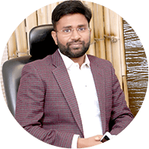


Directors Profile
Mr. Rahul Agarwal
Mr. Vijay Agarwal
Mr. Amit Jain
Mr. Rahul Agarwal aged 33 years, has more than 5 years of experience in the Real Estate sector.
After spending 5 years working at Ernst & Young, he began his first solo endeavour of teaching students worldwide, with the help of Indian teachers.
Awarded as Entrepreneur of the year Manufacturing Business-FMCG by Entrepreneur India,2018.
Awarded Young Entrepreneur by Small Business Awards 2018.
Mr. Vijay Aggarwal is a qualified Engineer by profession.
He has been actively involved in Real Estate Sector in Haryana, Delhi NCR & Rajasthan.
He has delivered projects with more than 1 million sq yards area, ranging from Residential, Commercial and Industrial Township.
He liaisons with Government Departments, and has been instrumental in getting various approvals for this project
Mr. Amit Jain is a dynamic professional, having more than 15 years experience working in the Indian Real Estate sector.
He has developed various Green Field projects like Warehousing, Residential township & Industrial plots.
He has exceptional knowledge in execution of complex projects, with in depth knowledge of governmental rules & regulations.
He is involved in the day to day operations of the company.
The Directors have vast experience in varied sectors
Private & Confidential

Slide 6








Organic Harvest
About Organic Harvest
Started in 2013 by Mr. Rahul Agarwal, Organic Harvest is a company with Ecocert certification.
Organic Harvest is an all-organic brand with an extensive Skincare, Haircare, Bodycare range and Essential oils.
The brand’s philosophy is rooted in crafting products that are organic, safe and offer long-term benefits. They are made from plants that are cultivated without the involvement of hazardous chemical fertilizers, herbicides or pesticides.
The products have no traces of harsh chemicals, parabens, phthalates, mineral oils, PABA, petrolatum, paraffin or any animal ingredients. This is what makes our range incredibly gentle, safe and potent.
Certifications
Awards Won
Organic Harvest is an Organic beauty and Personal care category brand.
Private & Confidential

Slide 7









Product Portfolio- Organic Harvest
Product Range
1. Hair Care
2. Face Care
3. Body Care
4.Hygiene
5. Ayurvedic Products
6. Oils
7. Anti Ageing Products
8. Makeup Removal
Wide range of organic products that are safe and offer long-term benefits
Private & Confidential

Slide 8




Transaction with Good Glamm
About Good Glamm
Deal Structure
The Good Glamm Group is South Asia’s Largest Content-to-Commerce Group which invests in innovative, fast-growing beauty & personal care brands.
The Good Glamm Group is focused on to build the global Digital FMCG Conglomerate of the Future.Backed by Leading Global investors like:Accel, Ascent, Amazon, Warburg Pincus, Prosus , Trifecta Capital, Wipro, Shraddha Kapoor, Mankekar Family office
The Good Glamm Group has acquired a majority stake in Organic Harvest, an organic beauty and personal care brand, in an all-cash deal.
The deal pegs Organic Harvest’s enterprise valuation at Rs 275-280 crore.
The D2C (Direct to consumer) firm invested Rs 75 crore as primary capital in the organic beauty and personal care brand.
This was Good Glamm’s seventh acquisition in the last 12 months and marks the foray of Good Glamm Group in the organic BPC (Beauty Personal Care) Category.
Organic Harvest has predominantly been an offline first brand.
Now, as part of the Good Glamm Group, Organic Harvest will be able to leverage the group's large digital audience." Organic Harvest has over 700 employees and all of them have been absorbed in the company.
Private & Confidential

Slide 9

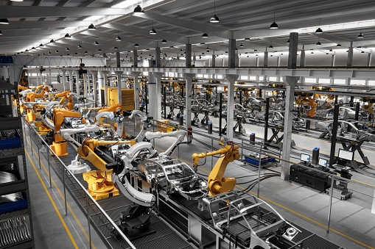

Maruti Suzuki Proposed Manufacturing Plant

Slide 10
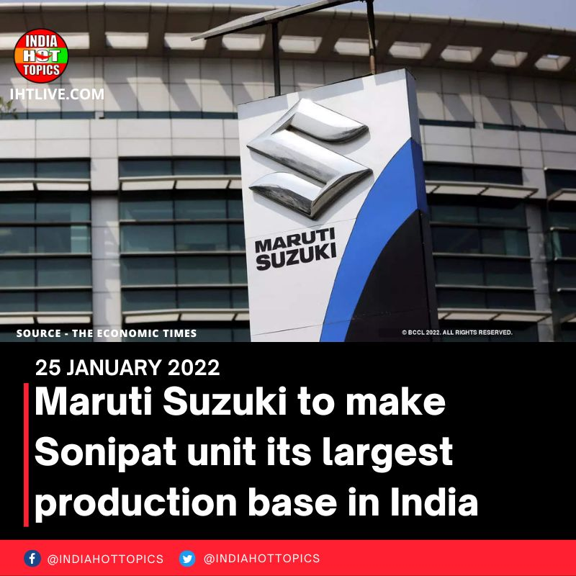
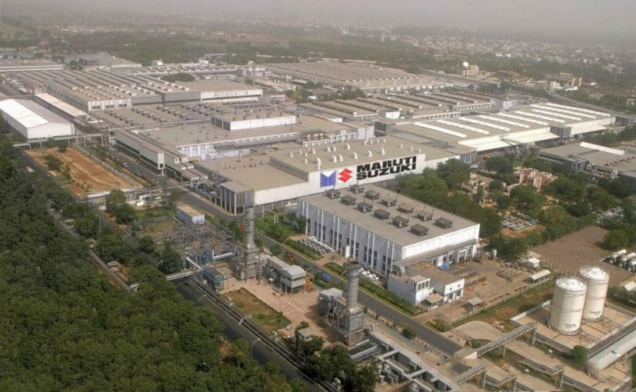
Maruti Suzuki Plant in Sonipat
The country's largest car maker Maruti Suzuki will commence construction of its new manufacturing facility located in Sonipat, Haryana.
It would emerge as the largest production base for Maruti in India.
The company has received all necessary clearances to set up a new plant on 900 acres of land at Kharkhoda in the Sonepat district.
Maruti Suzuki already has two plants in Manesar, Haryana and one in Gujarat
The first assembly line will be ready by 2025.
The Sonipat facility could have a total installed capacity of approx. Million units and can be further enhanced.
Private & Confidential

Slide 11
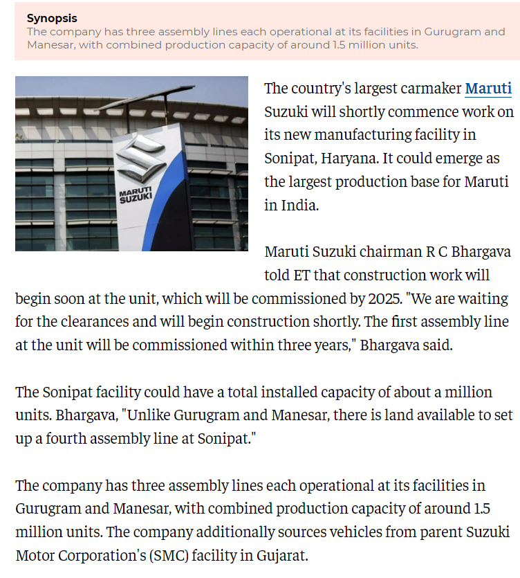
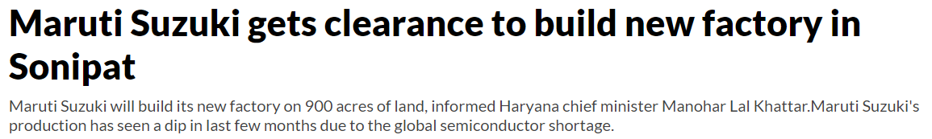
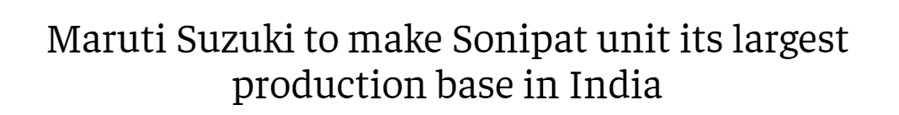
Maruti Suzuki Expansion Plan
Private & Confidential

Slide 12

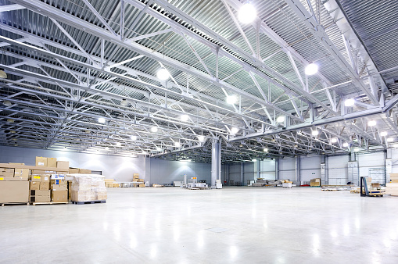
Our Advantage
Sr. No | Particulars | Remarks
1. | SGIT Location | Village Deoru & Jawahri, Sonipat
2. | Proposed Maruti Suzuki Plant | Kharkhoda in the Sonepat district.
3. | Distance from Industrial Park | 25 Km
4. | Demand Generators | Good size of plot available for setting up of manufacturing facilities by various OEM’s All approved land parcels in place Warehousing facility available Located on the main Highway All Amenities available for OEM’s Less than 1 hr Distance
The proposed Maruti Plant will also further generate demand for Industrial Parks through OEM’s.
Private & Confidential

Slide 13
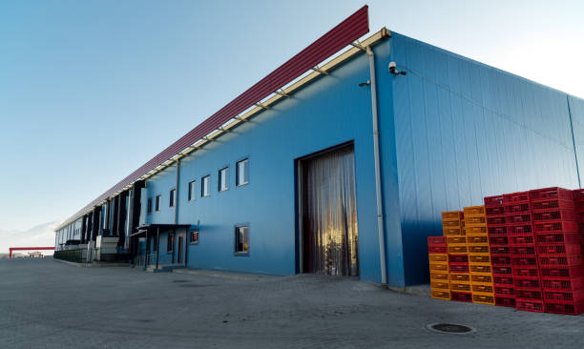
Project Overview

Slide 14
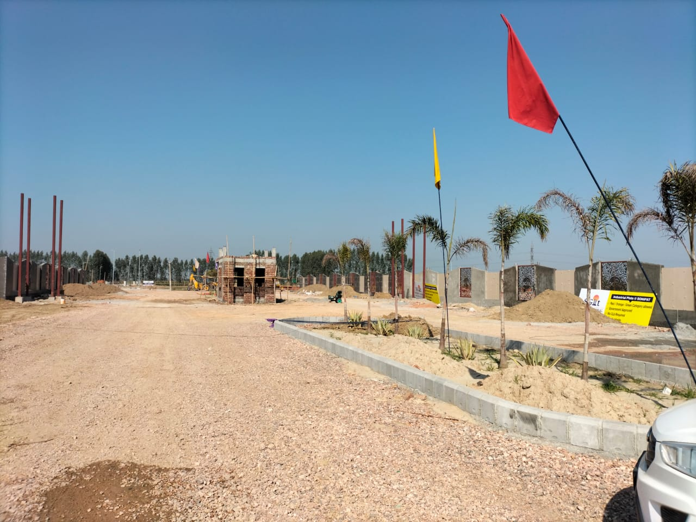
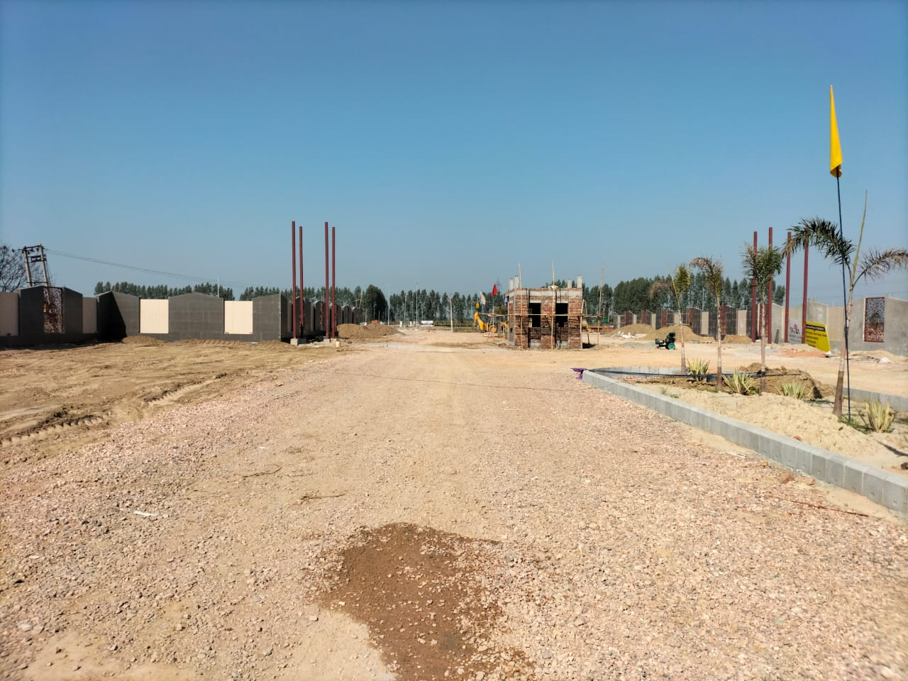
About the Project
Project Overview
Actual photos of the Site
The Company (M/s Syscom Edutech Pvt. Ltd. has acquired the land parcel measuring 45 Acre in Sonipat, Haryana in the year 2015.
The project is located at Village Deoru & Jawahri, Sonipat
The proposed Industrial shop will include Warehousing facility, SME and MSME Manufacturing Units and Commercial establishments.
As part of Phase I, 65% of land has already been sold to investors and end users.
Excellent location
Upcoming Mega Infrastructure projects in Haryana
The company is debt free as on date.
Huge demand due to upcoming Maruti Suzuki manufacturing plant.
Land Details
Sr. No | Particulars | Remarks
1. | Plot Area | 45 Acres purchased
2. | Area Developed | 21 Acres
3. | Under Development | 15.50 Acres (LOI received from Government)
4. | Area under LOI | The company shall apply for LOI for balance 11 Acres of land parcel
Private & Confidential

Slide 15
Company Structure
Shareholding Pattern
Sr. No | Name | Body Type | Nationality | % of Holding | No of Shares
1 | Mr. Amit Agarwal | Individual | Indian | 0.42% | 5,000
2 | Mr. Ashish Agarwal | Individual | Indian | 0.42% | 5,000
3 | Chahal Consulting FZE | Body Corporate | Foreign Entity - UAE | 99.16% | 11,79,038
 |  | Total |  |  | 11,89,038
The holding of the company is within the family members
Private & Confidential

Slide 16
Cost of Project & Means of Finance
Cost Incurred Till Date
Means of Finance
Particulars | Amount (Rs. In Crores)
Land Cost | 45.00
License Fees | 1.15
Interest during Construction | 1.62
Sewage pipes | 1.20
Road development | 2.50
Electricity | 2.50
STP | 1.00
Land levelling | 0.50
Miscellaneous | 5.00
TOTAL | 60.47
Particulars | Amount (Rs. In Crores)
Promoter Contribution | 60.47
Bank funding | 0.00
TOTAL | 60.47
The entire Project has been funded by Company own sources.
Private & Confidential

Slide 17


Key Features
Categories Allowed
Red/ Orange/ Green category Allowed
Government Approved
No CLU Required
Mortgage Approved
Industries with Pollution Index score of 60 and above: Red category
Industries with Pollution Index score of 41 to 59: Orange category
Industries with Pollution Index score of 21 to 40: Green category
Demand Scenario
All the industrial units in Delhi is receiving notices from Pollution Board to shift outside Delhi due to excessive pollution.
Licenses not getting renewed due to which there is lack of Choice for the Industries covered in red zone.
Private & Confidential

Slide 18
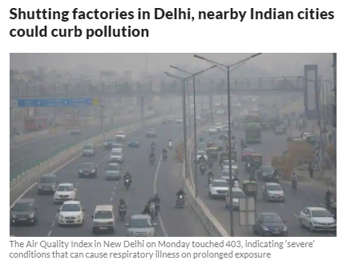

Potential Clientele
Land is the biggest constraint in Delhi. All the industrial units in Delhi is receiving notices from Pollution Board to shift outside Delhi.
Licenses not getting renewed due to which there is lack of Choice for the Industries covered in red zone.
There is existing list of 17 Red Category Industries as per Central Pollution Control Board as given below:
Aluminium smelter
Cement
Chlor Alkali
Copper smelter
Distillery including Fermentation industry
Dyes and Dye-Intermediates
Fertilizer ( basic) ( excluding formulation)
Iron and Steel (involving processing from ore/integrated steel plants)
Oil Refinery (Mineral Oil or Petro Refineries)
Pesticides (Technical) (excluding formulation)
Petrochemicals ( Manufacture of and not merely use of as raw material)
Pharmaceuticals (excluding formulation)
Pulp and Paper (paper manufacturing with or without pulping)
Sugar (excluding Khandsari )
Thermal Power Plants
Zinc smelter
Tanneries
Private & Confidential

Slide 19

Potential Clients for Relocation/ Expansion
Potential Clients for Relocation/ Expansion are mainly existing units in the following Industrial areas in Delhi:
  Units in Naraina Industrial area
  Units in Mayapuri Industrial area
  Units in Anand Parbat Industrial area
  Units in Peeragarhi
  Units in Nangloi
  Units in Wazirpur
  Units in Lawrence Road
  Units in Badli
  Units in Bawana
  Units in Narela
  Units in Mangolpuri
  As per the data available, the above units in these areas are over 5,000 units which would be potential customers for Relocation/ Expansion

Slide 20
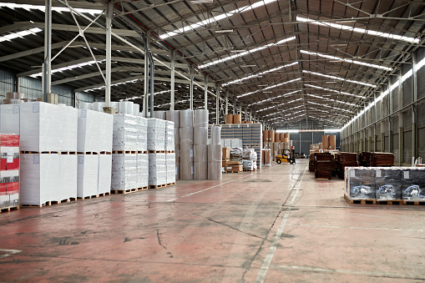

Project Highlights
1.
2.
3.
4.
5.
6.
7.
8.
9.
10.
Strategically located in the National Capital Region (NCR) having strong connectivity to Delhi and other Towns in the region and National Highways
Located at the western border of National Capital Territory of Delhi (NCTD)
Located along the Kundli Manesar Palwal (KMP) Expressway
Strategically located among in the industrial hubs of the region
Rail connectivity to the Northern Railway line and linked to the Dedicated Freight Corridor (DFC) of Delhi Mumbai Industrial Corridor (DMIC)
Strong Promoter Credentials
Ready availability of freehold land for immediate development.
Development of Phase I Industrial Colony on 45 acres in progress. Additionally 45 acres of land under grant of license
Greenfield Project - Opportunity for development of the state-of-art economic enclave
DFC, DMIC and the KMP Expressway will enhance core infrastructure and create complementary economic activities
Private & Confidential

Slide 21
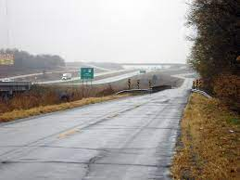
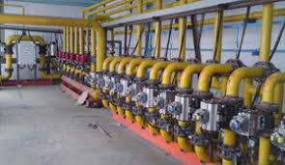

Infrastructure Strength
Sr. No. | Particulars | Remarks
1. | Power | The project will establish 2500 - 5000 KVA GIS substations, as these are connected to the national grid, hence ensuring good reliability of power
2. | Roads | The company has built roads within the Industrial Township which is 20 metres wide.
3. | Water | The Government has approved allocation of water for the SGIT Project.
4. | Residential and Social Infrastructure | The Project is planned as a self-sufficient township addressing the residential and social infrastructure needs of the proposed economic development infrastructure. The project is proposed to have a blend of industrial, residential, commercial and Warehousing.

Slide 22










Amenities offered
Roads
Water
Solar Panels
Maintenance
Rainwater harvesting
CCTV
Ample Parking
Security
Electricity
Sewerage
The project is thoughtfully planned ensuring the smallest of conveniences at your footstep.
Private & Confidential

Slide 23
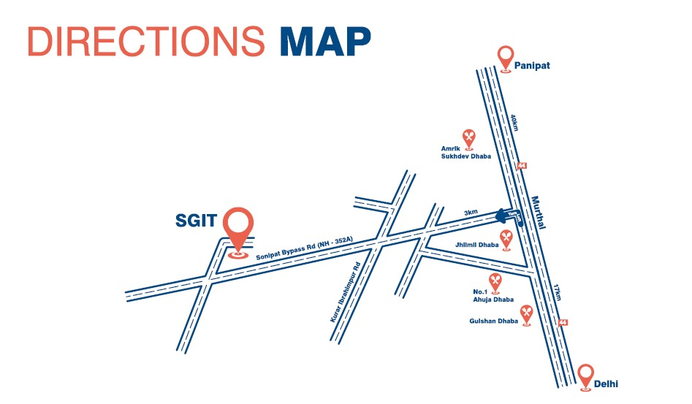
Strategic Location
Direction Map
Distance from Site
Sr. No. | Particulars | Kms
1. | NH 1 GT Road | 3 Km
2. | Delhi | 20 Km
3. | KMP Expressway | 15 Km
4. | Railway Station | 7 Km
5. | Airport | 60 Km
6. | Murthal Dhaba | 3 Kms
The Industrial Township is located in close proximity to the Expressway aiding in easy Transportation of goods.
Private & Confidential

Slide 24
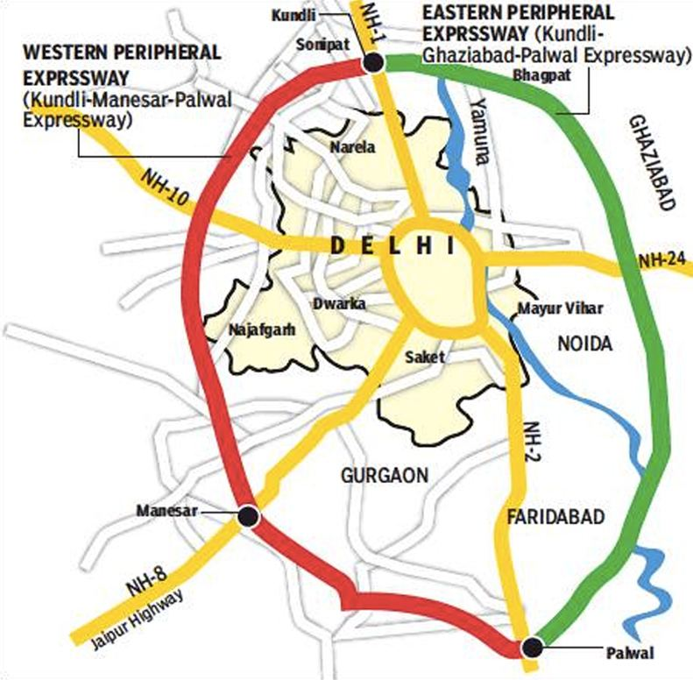
Strong Connectivity
Sonipat Global Industrial Township is strategically located with strong connectivity.
The Proposed site is located around 3 km from National Highway No. 1 and near to NH 352A which is considered as one of the prime and suitable location for the Industrial units.
Location at near the Northern border of National Capital Territory of Delhi (NCTD).
Rail connectivity to the Northern Railway line and liked to the dedicated freight corridor (DFC).
Strategically located among in the Industrial hubs of the region
Easy access to the Indira Gandhi International hubs of the region.
Located near the Kundali Manesar Palwal (KMP) Expressway.
The project is thoughtfully planned ensuring the smallest of conveniences at your footstep.
Private & Confidential

Slide 25
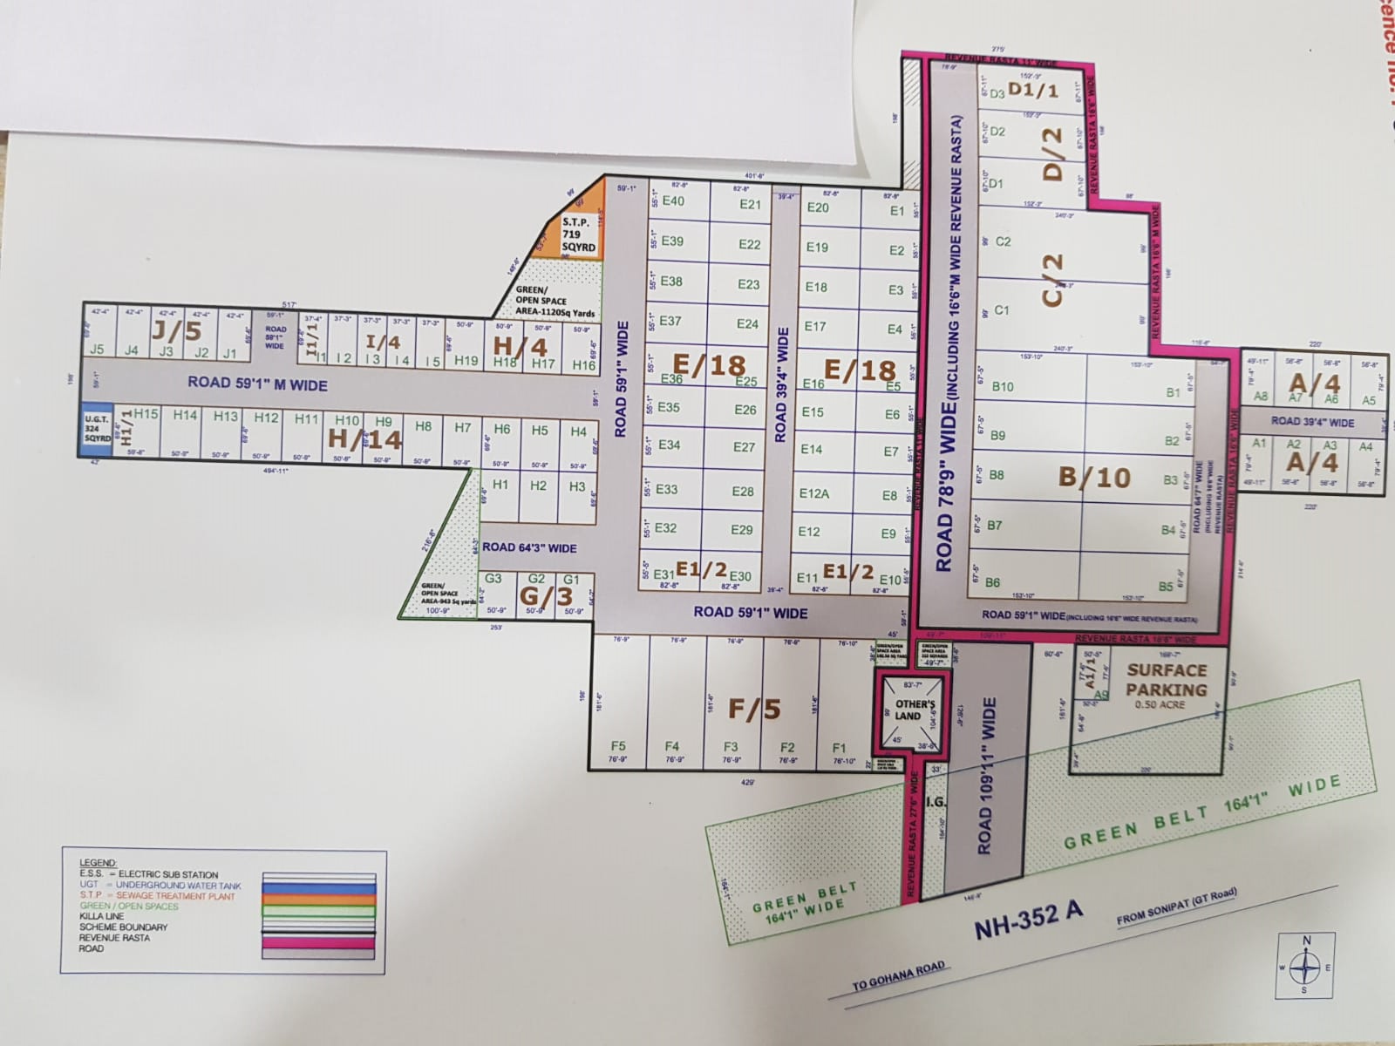
Plot Layout – Phase I
The Industrial Township is well planned and comprises of plots of different sizes.
Private & Confidential

Slide 26
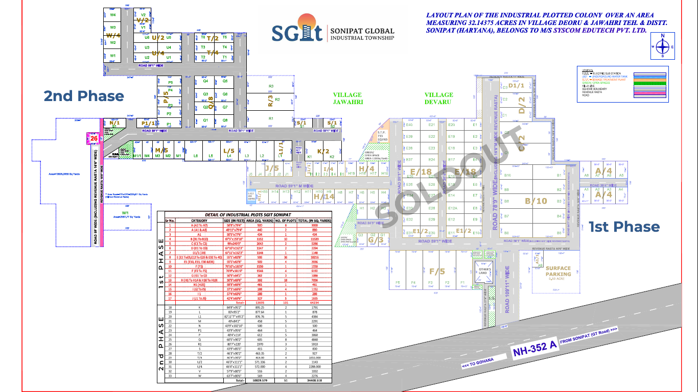
Plot Layout – Phase I and Phase II

Slide 27
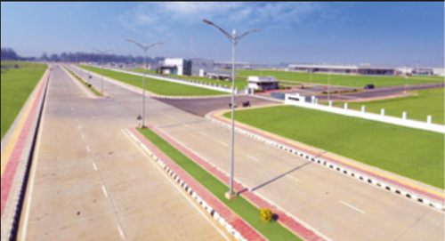
Land Details
About Plot Area
About Saleable Area
Sr. No | Particulars | Remarks
1. | Plot Area | 45 Acres purchased
2. | Developed | 21 Acres
3. | Under Development | 15.50 Acres LOI received from Government
4. | Area under LOI | The company shall apply for LOI for 11 Acres of land parcel
Sr. No | Particulars | Remarks
1. | Total saleable area | 1,00,000 Sq. yards
2. | % area sold | 65% area sold
3. | Area sold (sq. Yards) | 65,000 yards
4. | Potential Price to be realized | Rs. 35,000 per Sq. yard
Private & Confidential

Slide 28

Plot Details – Phase I
CATEGORY | SIZE (IN FEET) | AREA (SQ.YARDS) | NO. OF PLOTS | TOTAL (IN SQMT)
A (A2 TO A7) | 56'8"X79'4" | 500 | 6 | 3,000
A (A1 & A8) | 49'11"X79'4" | 440 | 2 | 880
A1 | 50'5"X77'6" | 434 | 1 | 434
B(B1 TO B10) | 67'5"X153'10" | 1152 | 10 | 11,520
C(C1 TO C2) | 99'"X240'3" | 2643 | 2 | 5,286
D(D1 TO D3) | 67'10"X152'3" | 1147 | 2 | 2,294
D1/1(D3) | 67'11"X152'3" | 1148 | 1 | 1,148
E(E1 To E9,E12 To E29 & E32 To 40) | 55'1"X82'8" | 506 | 36 | 18,216
E1(E10,E11,E30 & E31) | 55'5"X82'8" | 509 | 4 | 2,036
F (F1) | 76'10"X181'6" | 1550 | 1 | 1,550
F (F2 to F5) | 76'9"X181'6" | 1548 | 4 | 6,192
G ( G1 to G3) | 50'9"X64'2" | 362 | 3 | 1,086
H (H1 To H14 & H16 To H19) | 50'9"X69'6" | 392 | 18 | 7,056
H1(H15) | 59'8"X69'6" | 461 | 1 | 461
I (I2 To I5) | 37'3"X69'6" | 288 | 4 | 1,152
I1 | 37'4"X69'6" | 288 | 1 | 288
J (J1 to J5) | 42'4"X69'6" | 327 | 5 | 1,635
 | TOTAL 101 |  |  | 64,234
There are a total of 101 plots of different sizes in Phase 1 of the project
Private & Confidential

Slide 29

Plot Details – Phase II
CATEGORY | SIZE (IN FEET) | AREA (SQ.YARDS) | NO. OF PLOTS | TOTAL (IN SQMT)
K | 84'8"X95‘2" | 895.25 | 2 | 1,791
L | 83’X95‘2" | 877.64 | 1 | 878
L1 | 82‘11“7“’X95‘2" | 876.76 | 5 | 4,384
M | 49'X84‘2" | 458 | 5 | 2,291
N | 43’9”X102‘10" | 500 | 1 | 500
P1 | 43‘9"X95‘6" | 464 | 1 | 464
P | 48‘4"X114' | 612 | 5 | 3,060
Q | 60‘5"X90‘2" | 605 | 8 | 4,840
R1 | 80‘7"X220' | 1970 | 3 | 5,910
S | 43‘9"X85‘5" | 415 | 2 | 830
T/2 | 46‘3"X90‘2" | 463.35 | 2 | 927
T/4 | 46‘4"X90'2" | 464 | 4 | 1,856
U/2 | 46‘3"X111‘1" | 571.336 | 2 | 1,143
U/4 | 46‘4"X111‘1" | 572 | 4 | 2,288
V | 57‘9"X80‘5" | 516 | 2 | 1,032
W | 63‘7"X80'6" | 569 | 4 | 2,276
 | TOTAL AREA |  |  | 34,470

Slide 30
Comparison
Price with Neighbouring Industrial Parks
Sr. No. | Particulars | Ownership | Total Land area | Present Market Price per Sq. yard | Distance from SGIT
1. | Kundli Industrial Township | HSIDC (Haryana State Industrial Development Corporation) | 560 Acres | 60,000 – 75,000 | 35 Kms
2. | Barhi Industrial Township | HSIDC | 600 Acres | 35,000 – 40,000 | 28 Kms
3. | Industrial Model Township (IMT, Kharkhoda) | HSIDC | 3,000 Acres | 45,000- 50,000 | 25 Kms
Other Factors
Sr. No. | Particulars | HSIDC | DSIDC | UPSIDC
1. | Electricity Prices | Rs. 125 up to 2 kW and Rs. 75 above 2 kW | Rs. 120 up to 2 kW and Rs. 65 above 2 kW | Rs. 115 up to 2 kW and Rs. 62 above 2 kW

Slide 31
Expansion Plan
Proposed Township
The proposed Township will have a total area of 250 Acres with the state of the art facilities and will be a mix of Industrial, Warehousing, Residential with commercial facilities.
The entire 250 Acres is being proposed as one entire parcel of Land comprising with the above facilities.
Sr. No | Particulars | Remarks
1. | Proposed Plot Area | 250 Acres
2. | Under Development | 45 Acres
 | Area under LOI | 11 Acres
 | Area under Development | 36.50 Acres
3. | Area under Aggregation of Land | 205 Acres
Sr. No | Land area | % of Land | Remarks
1. | 175 Acres | 70% | Industrial development
2. | 50 Acres | 20% | Warehousing
3. | 12.50 Acres | 5% | Residential Development
4. | 12.50 Acres | 5% | Commercial
The promoters plan to make this as the Second integrated Township in Haryana, after Reliance Modern Economic Township
Private & Confidential

Slide 32


Our Proposal
We are seeking the following:
Partner having executed Integrated Township for Brand Alliance
Equity Partner for further development of the Township.
Equity Partner for developing state of the art Warehousing Facility.
Tie up with Banks for promoting SME Units being set up in the Township.
Private & Confidential

Slide 33
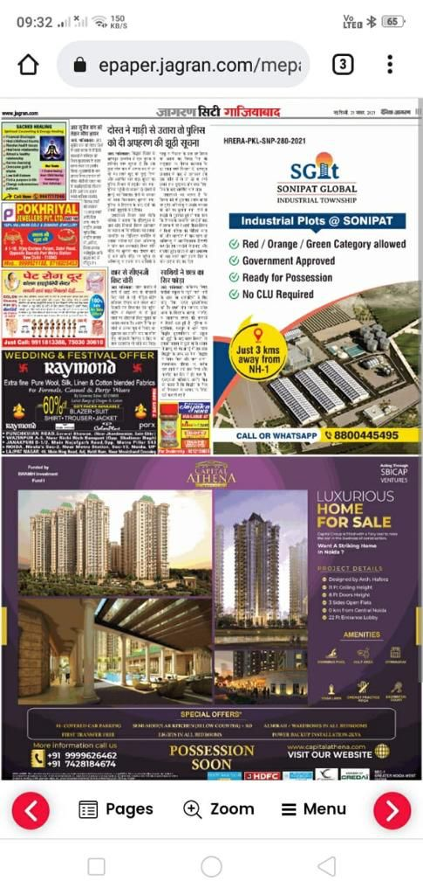
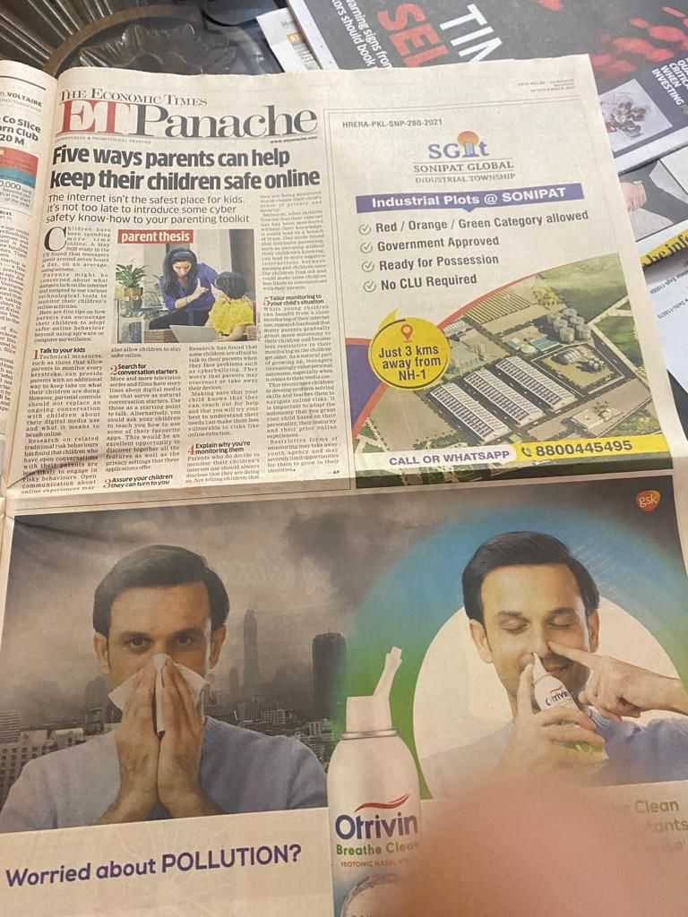
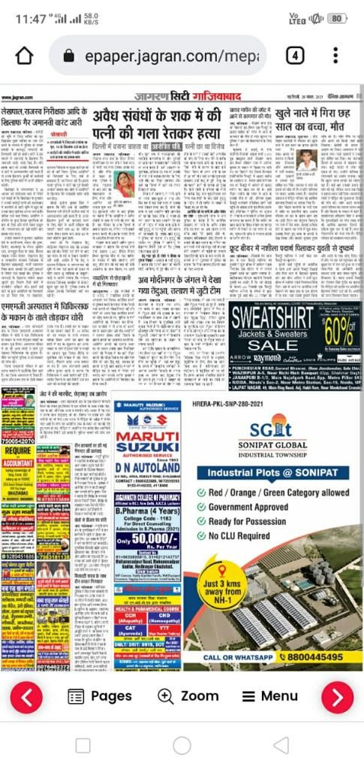
Newspaper Advertisement
Private & Confidential

Slide 34
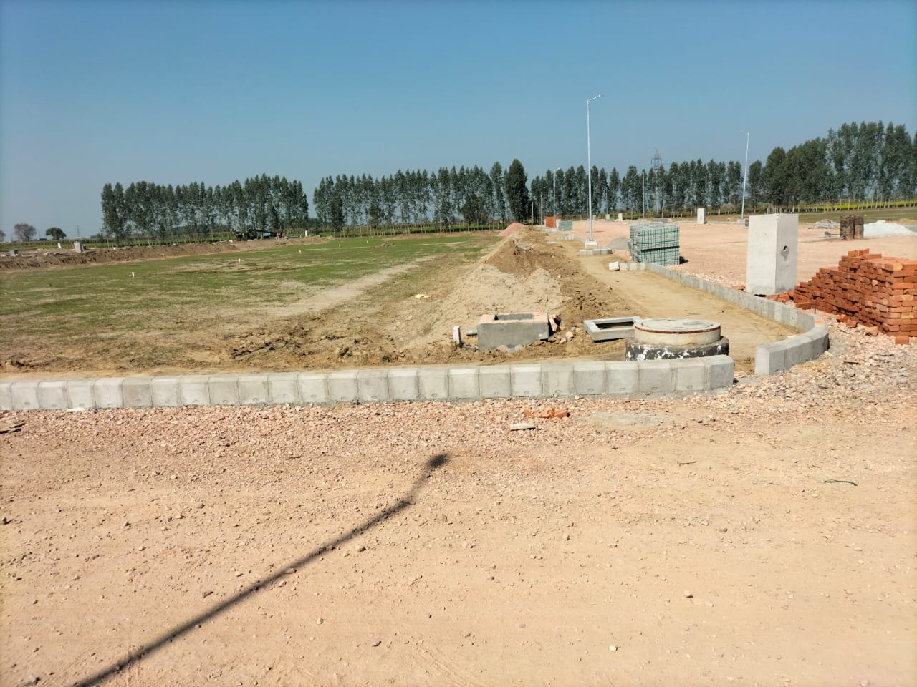
Actual Photos (1/2)
Private & Confidential

Slide 35
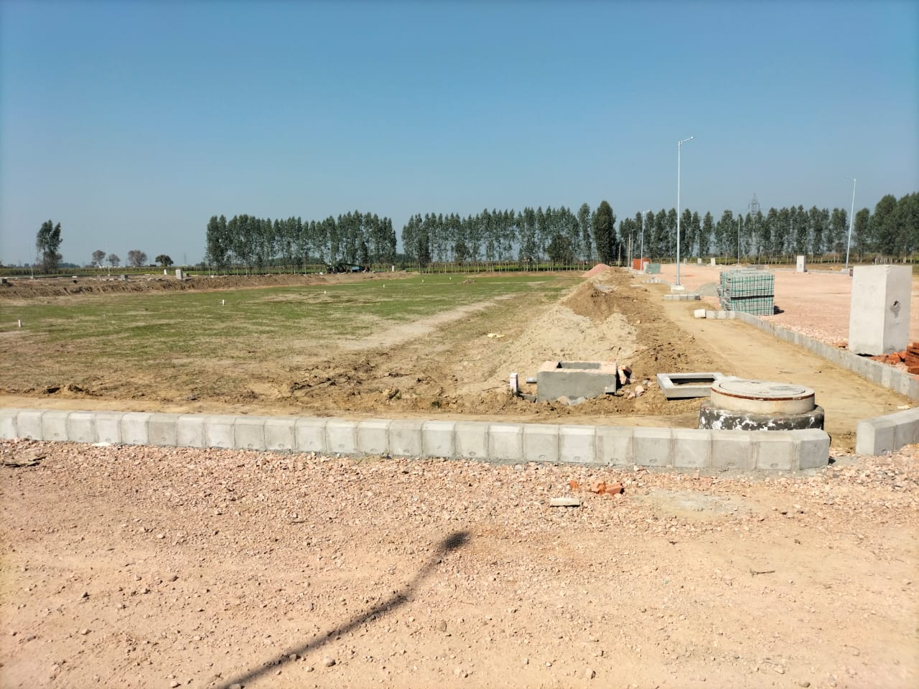
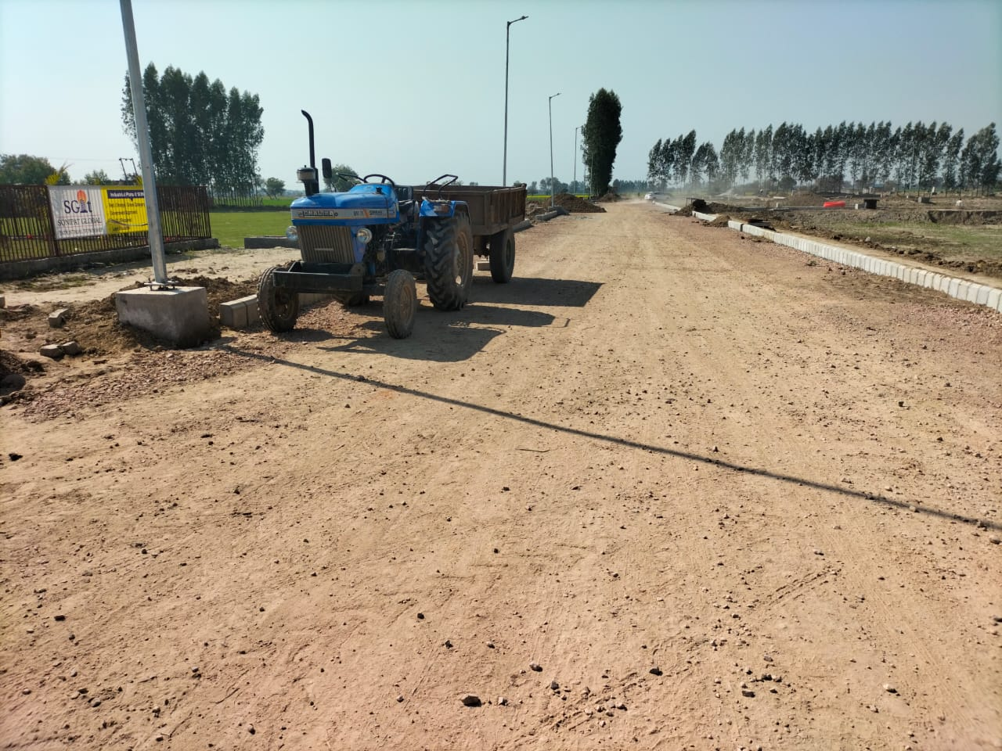
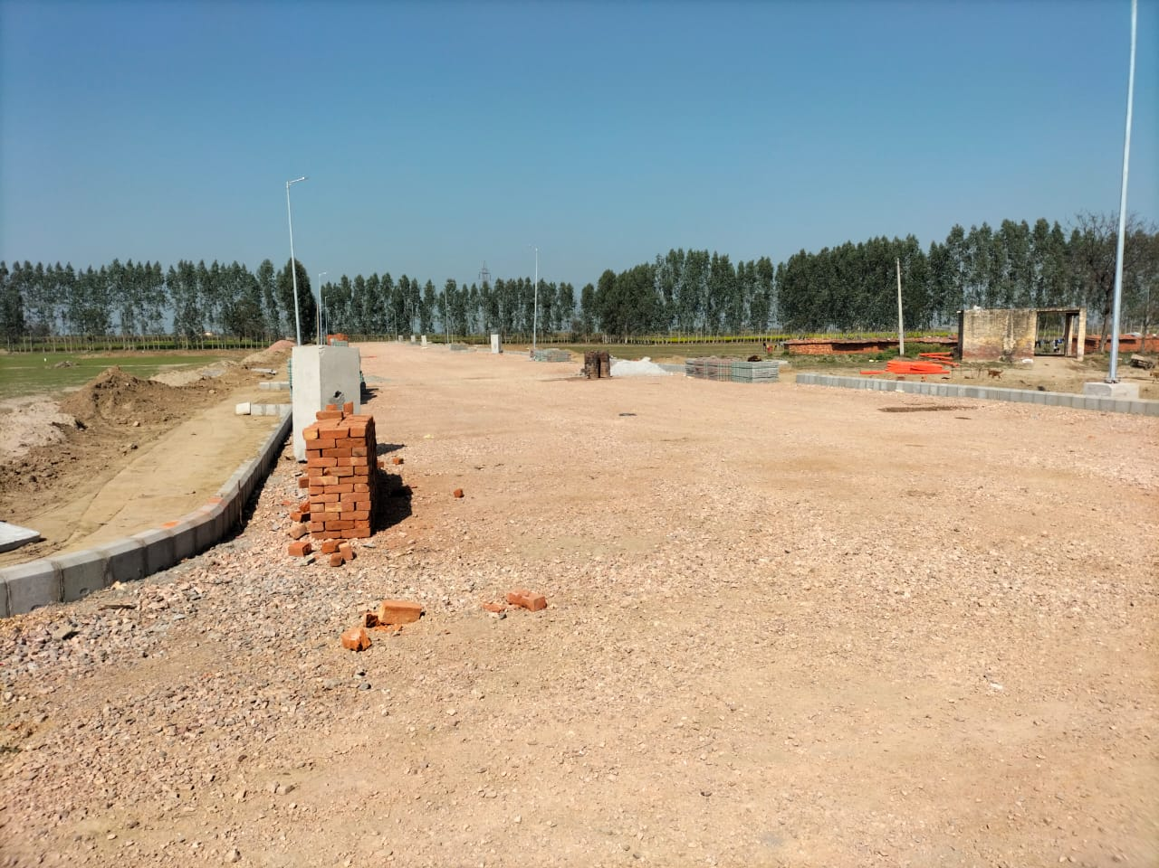
Actual Photos (2/2)
Private & Confidential

Slide 36

Contact Us
Mr. Ranjit Khattar
Managing Partner
Email: ranjit@xpressfunding.in
Mob. No: +91-98100 29349
Thank You
Mr. Vipin Makhija
Project Head
Email: vipin@sgit.co. in
Mob. No: +91-9582206501
Mr. Akash Khattar
Associate Vice President
Email: akash@xpressfunding.in
Mob. No: +91-96544 17444
Private & Confidential

